Slide 1
SSWH6: describe the diverse characteristics of early African societies before 1500 ce.

Slide 2
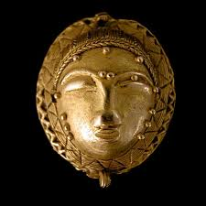
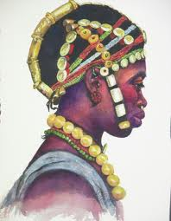
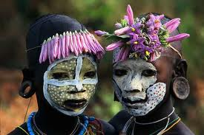
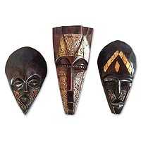
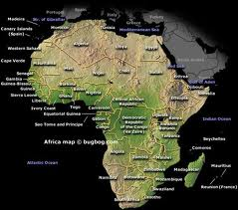
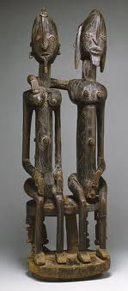
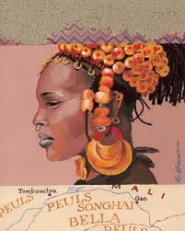
EARLY AFRICAN KINGDOMS

Slide 3
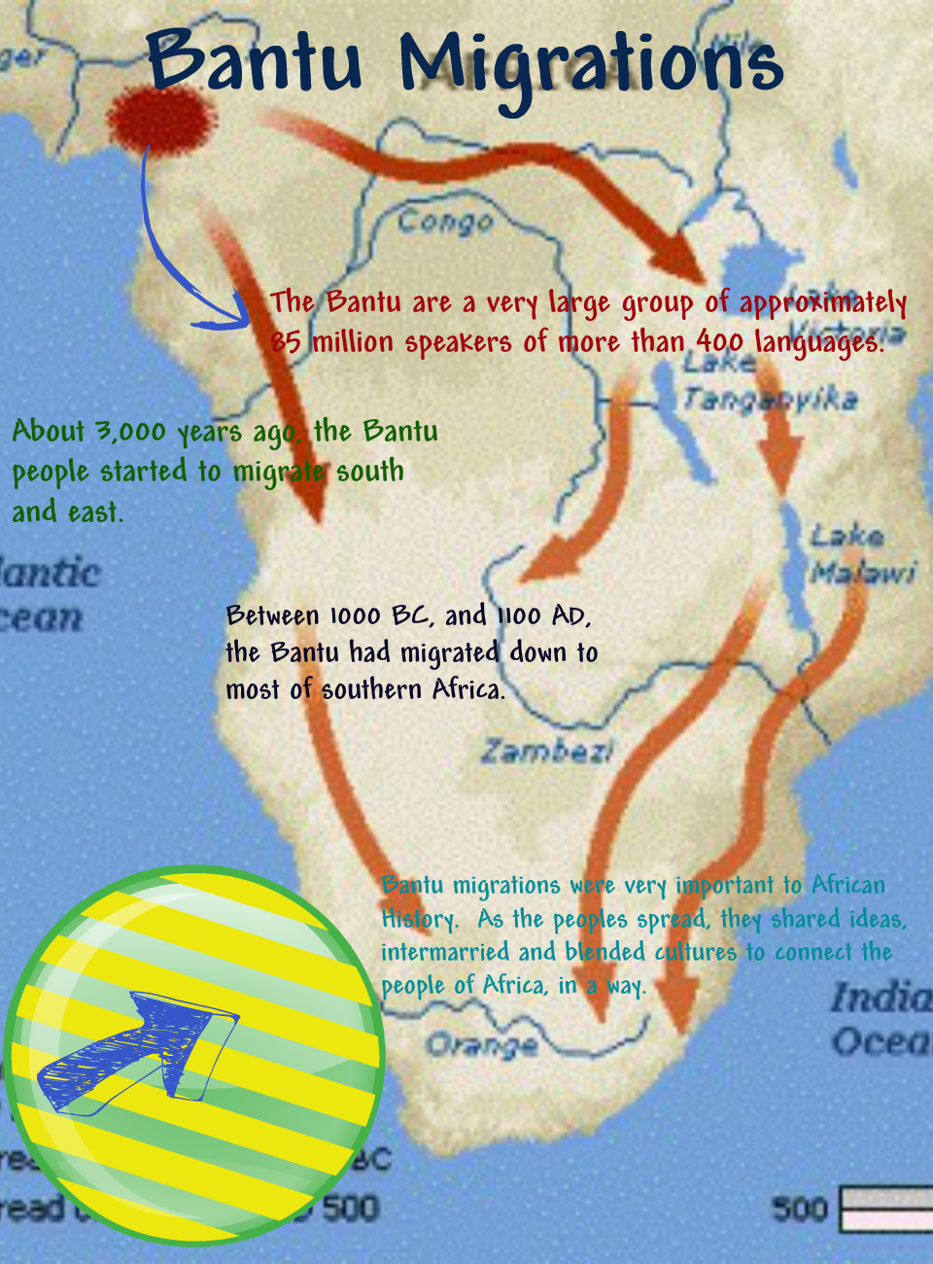
BANTU MIGRATION:
Africa: home of the earliest ancestors of modern people
West African farmers & herders migrated south, all speaking many different languages all derived from one language, Bantu
Migration spread from West Africa to Central and South Africa
Bantu speakers spread their language and skills all throughout Africa
African languages today have Bantu roots

Slide 4
SUDANIC KINGDOMS (WEST AFRICA):
GHANA
MALI
SONGHAI

Slide 5
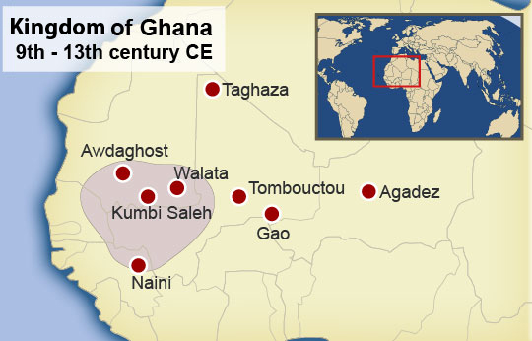
GHANA:
DEVELOPMENT:
Created by many farming villages
Prosperous because it taxed the gold-salt trade.
King controlled gold price, demanded high taxes, and commanded large army.
Islam
spread through trade routes to Ghana
Ghana maintained their traditional beliefs but adopted some Islamic beliefs also.
DECLINE:
Muslims from North Africa launched an attack which made Ghana weak
Replaced by the powerful kingdom of Mali

Slide 6
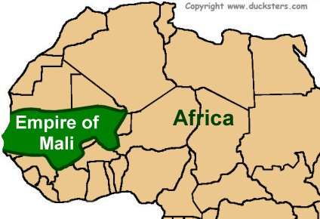
MALI:
DEVELOPMENT:
Founder: Sundiata (1st King)
Sundiata crushed enemies, gained control of gold trade
Mansa Musa:
King of Mali who expanded empire.
Converted to Islam
Adopted Sharia law but promoted religious freedom and tolerance
Pilgrimage
Completed a hajj to Mecca in 1324.
Made “friends” with other Muslim nations which made Mali more powerful.
DECLINE:
Disputes over succession weakened empire
People left the empire and it began to decrease in size

Slide 7
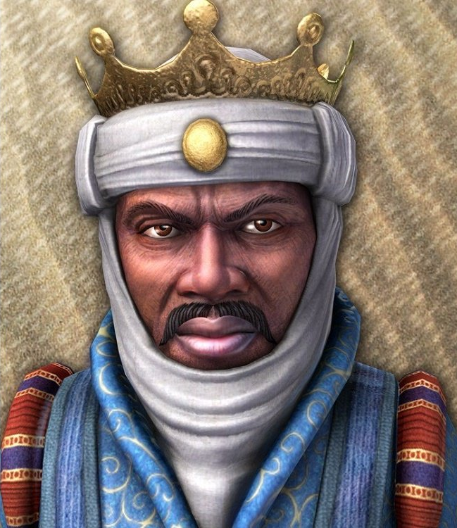
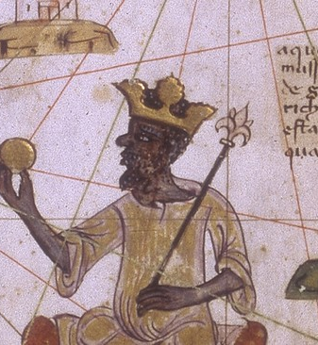

Slide 8
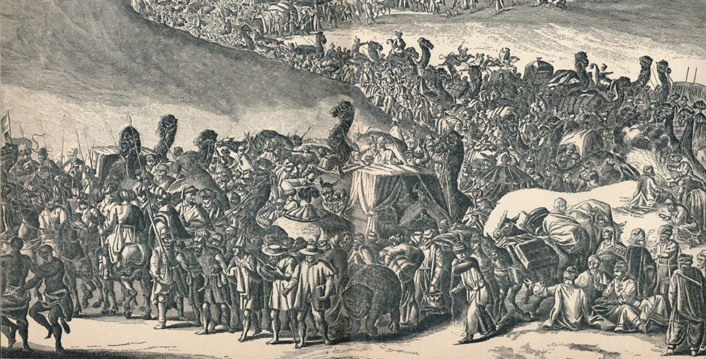

Slide 9
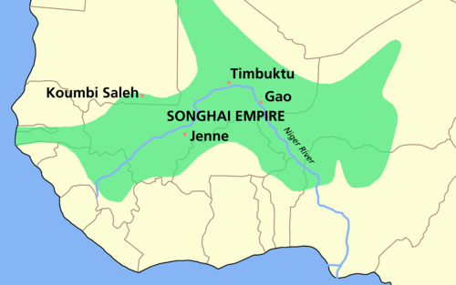
Songhai:
DEVELOPMENT:
Replaced Mali as lead state in West Africa.
Largest of West African states.
Rulers and subjects were Muslim.
Mosques and schools studying Islam.
DECLINE:
Frequent changes in leadership
Civil war
Fell because they did not have gunpowder.

Slide 10
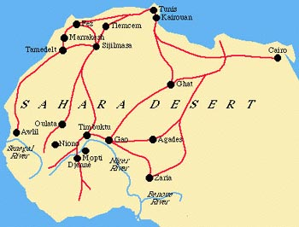
TRADE IN AFRICA:
Camels enable traders to trek across Sahara.
Gold and Salt
West Africans control this trade and become very prosperous.
Trans-Saharan Trade Network
Camel caravans traveled across the Saharan desert into West Africa.
Islam became the dominate religion in sub-Saharan Africa.

Slide 11
TRADE IN AFRICA:
Trade occurred in Indian Ocean
East African international trade system led to a new culture & language: Swahili
Language: Arabic words absorbed into Bantu-based language
Primarily traded slaves with Middle East & India

