Slide 1
Absolute Monarchs
SSWH14

Slide 2
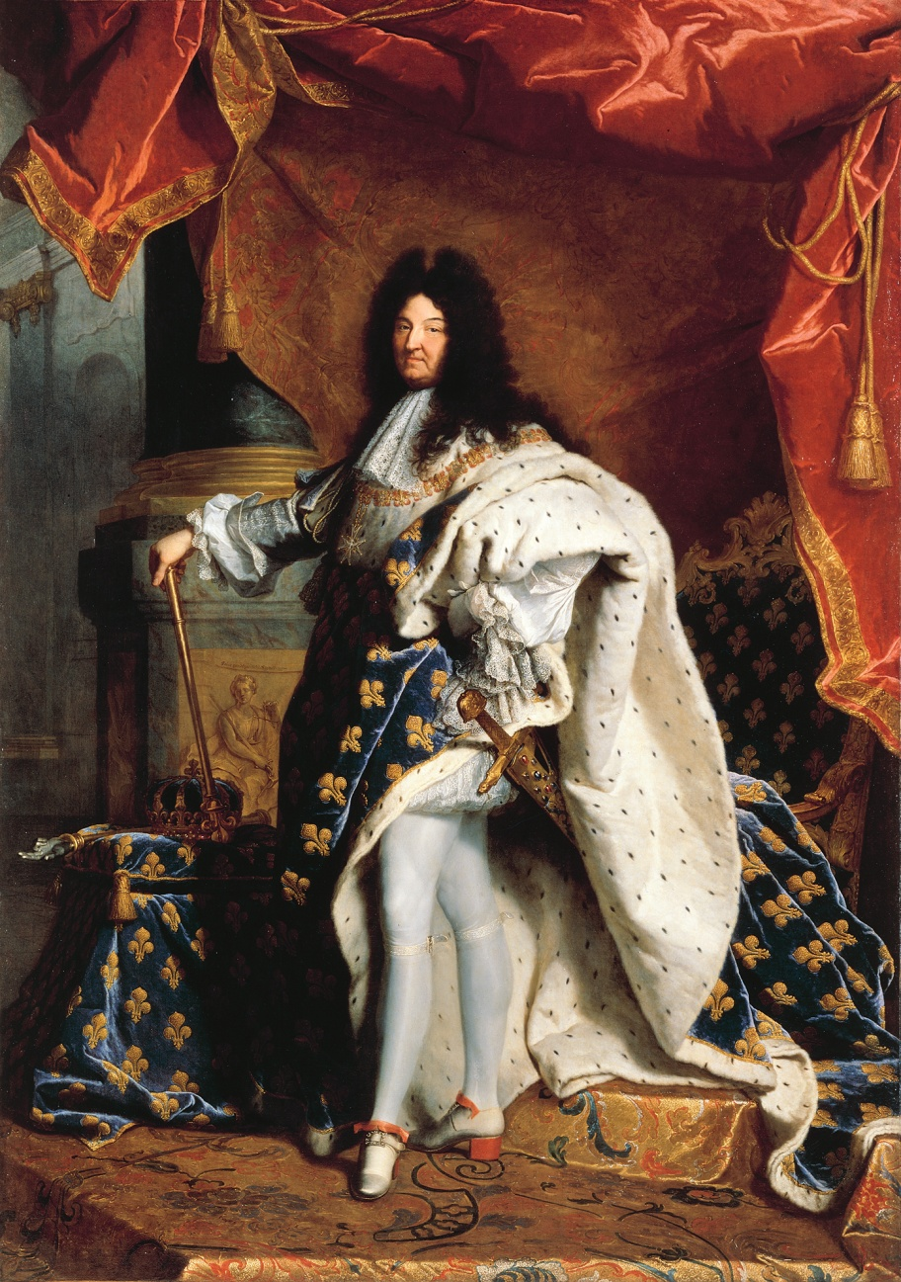
Louis XIV (France)
Known as the “Sun King”, Louis XIV, believed in the divine right of kings
He controlled the power of France’s upper class
limited the power of the church
Supported the arts and literature
Reign lasted 72 years

Slide 3
Tsar Peter the Great (Russia)
Took control of Russia’s Eastern Orthodox Church
He reduced the power of the large landowners
Pushed education reforms
“westernized” Russia
Reigned for 42 years

Slide 4
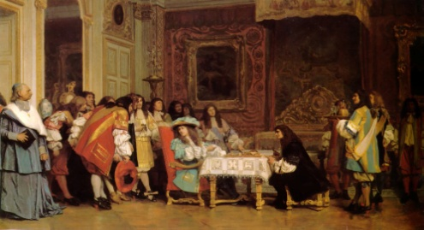
Absolute Monarchs
Louis XIV
Peter the Great
Tokugawa Ieyasu
Control of
Power
Limited the Power of the Upper Class
Reduced the power of the large landowners
Redistributed land among the upper class
Arts
Supported the arts and literature
Westernized Russia, including education reforms
Supported the arts and literature
Religion
Took control of the Church
Took control of the Church
Controlled religious choice

Slide 5
Age of Revolutions
SSWH14

Slide 6
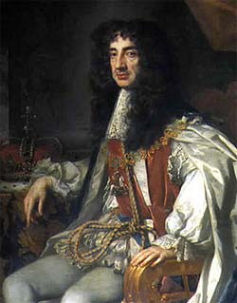
England’s “Glorious Revolution” (1689)
Two bad monarchs
1. Charles II
Parliament limited the power of the monarchy
Gave more rights to citizens
Charles died in 1685 with no heirs
His Catholic brother became King
2.James II
James II
Why would a Catholic King concern the English Parliament?

Slide 7
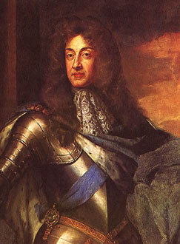
James II
Violated English law
Appointed several Catholics to positions of high office
After Parliament protested, James dissolved it
James believed in the absolute power of the King. Why would this concern Parliament?

Slide 8
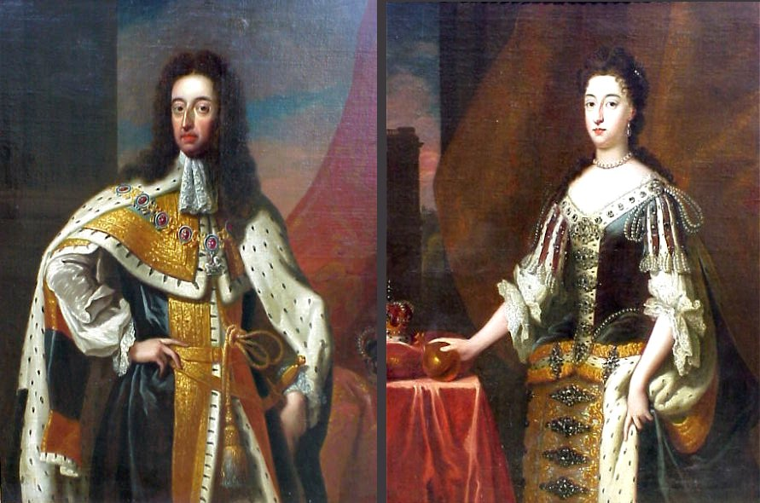
William and Mary
Parliament asked Mary, James’ Protestant daughter, to take over the throne with William
James didn’t resist
William and Mary formed a constitutional monarchy with Parliament (The Glorious Revolution)
Signed the English Bill of Rights

Slide 9
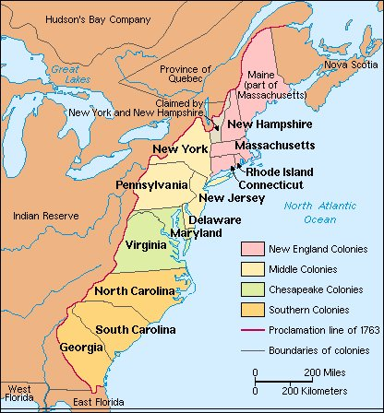
The American Revolution (1776)
By the mid 1700s:
-English colonists had lived in North America for nearly 150 years
-The British colonies had developed trade with much of Europe
-Many colonists had been born in North American and not England
-Colonial leaders were inspired by Enlightenment Ideas
By the mid 1700s, who would have many colonist related more to, England or the colonies? Why?

Slide 10
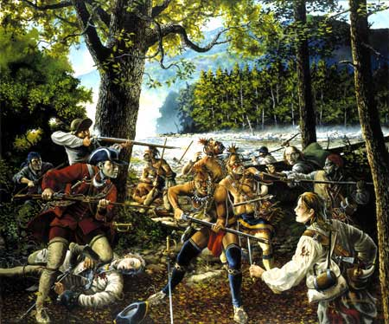
The American Revolution
Causes:
England taxed European goods, and restricted colonial trade
1754- French and Indian War
England vs. France/Native Americans
England forbids colonists from entering Indian lands
Proclamation Line of 1763
Colonists could not move west of Appalachian mountains

Slide 11
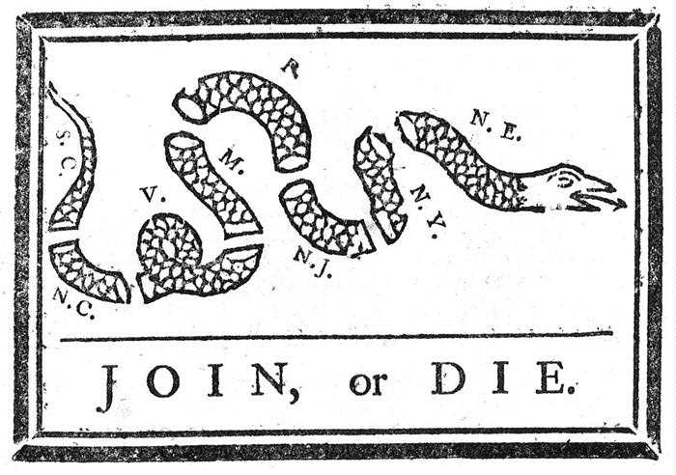
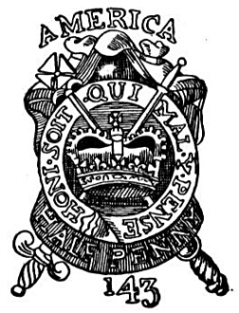
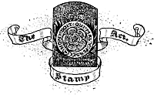
The American Revolution
England left in debt
America should pay
In 1765, Parliament passed the Stamp Act,
Taxed colonial newspapers
wills, deeds, and playing cards among other things
The colonists protested this “direct tax”

Slide 12
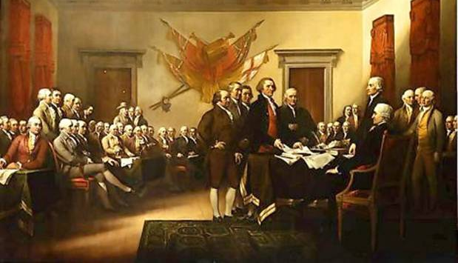
Results of the American Revolution
Colonists fought England for Independence and Won
The colonies formed a new, separate government
Established the American Constitution
Inspired other countries to revolt and form democracies
Franklin and Jefferson become leaders of the American Enlightenment

Slide 13
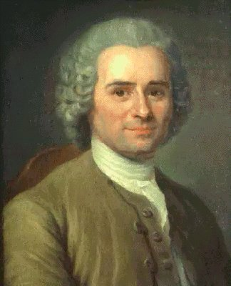
French Revolution (1789)
3 Social Classes (estates):
1st Estate: Clergy
2nd Estate: nobles, held
offices of power
3rd Estate: middle, and
lower classes, 97 %
of France belonged to
this class
The clergy and nobles owned over 30% of the land, and paid very few taxes
Why would members of the 3rd Estate feel inspired by Enlightenment ideas?

Slide 14
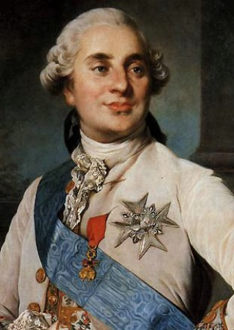
French Revolution
Issues:
Weak economy by the 1780s
crop failure
Poor weather
sky-rocketing food prices
Debt from American Revolution
King Louis XVI and Marie Antoinette (Queen) spent lavishly, until France was nearly bankrupt

Slide 15
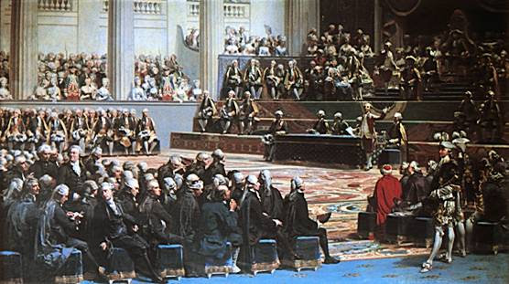
French Revolution
To generate needed revenue, Louis XVI wanted to tax the 2nd Estate at a meeting of the Estates General
At this meeting, with members of the clergy and nobles joining them, the 3rd Estate representatives called for the end of the absolute monarchy
The Estates General
was a meeting of all
three Estates, with
the 3rd Estate normally
given very little voting
power.

Slide 16
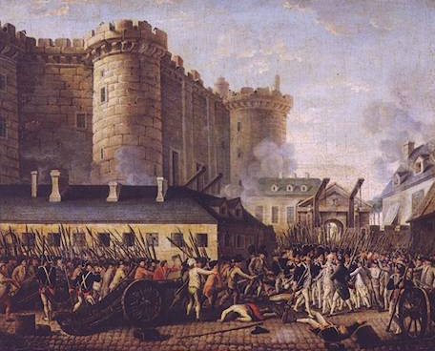
French Revolution
Peasants in Paris, afraid that the King would put down the Estates General by force, and by rumors of foreign troops invading France, attacked the Bastille, in search of gun powder and arms
French peasants stormed the Bastille (armory) in Paris
The rebellion eventually spread to the French countryside,
King and Queen were executed

Slide 17
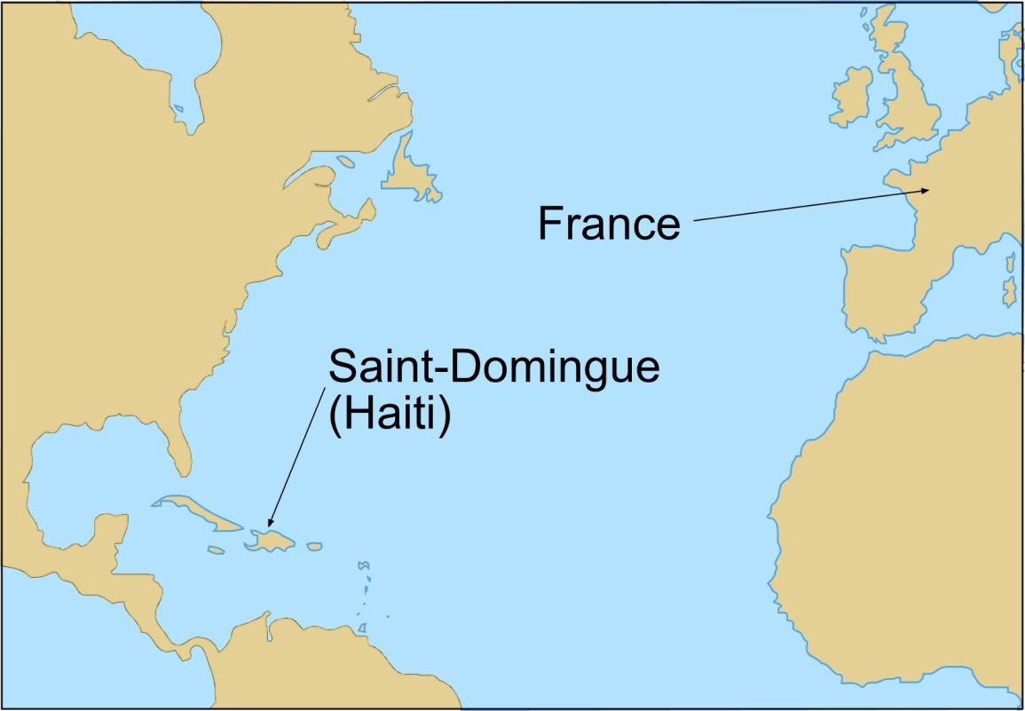
Haitian Revolution (1791)
Haiti (Saint Domingue), was a French colony in the Caribbean
Large producer of sugar
Contained numerous plantations with slaves
Slaves were brought in to work in the cane fields and outnumbered free people 10 to 1

Slide 18
Haitian Revolution
Slave ownership in Haiti was different than the American slave system:
-Haitian slaves were mostly African born
-Conditions in Haiti were harsh, with many slaves dying from overwork and the lack of food, clothing, and shelter
In 1791, The French Revolutionary government, granted citizenship to wealthy, freed men “of color”
The French plantation owners in Haiti refused to recognize this order
Fighting broke out between slaves and the owners
Slave Revolt
Led by Toussaint L’Ouverture
With France in disarray, the French couldn’t send a massive army over to Haiti to quell the rebellion

Slide 19
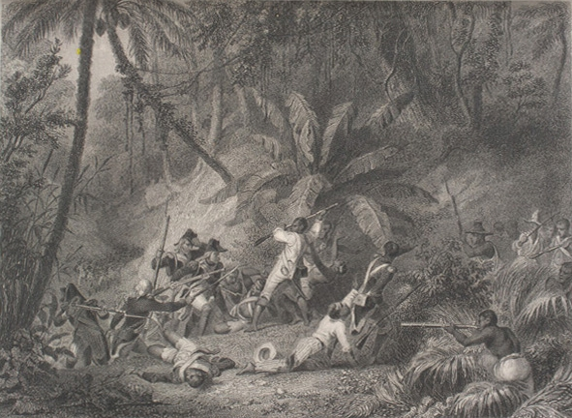
Results of the Haitian Revolution
Haiti = 1st Latin American country to gain independence from a European power
The loss of Haiti convinced Napoleon to abandon interest in North America
Result: Sale of the Louisiana Territory to the U.S. in 1803

Slide 20
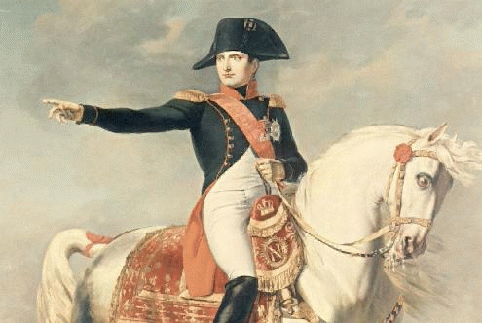
c. Explain Napoleon’s rise to power, the role of geography in his defeat, and the consequences of France’s defeat for Europe.

Slide 21
Napoleon
French general
Won several key victories for France during the 1790s
After returning to France from key victories in Austria and Italy, Napoleon found the post revolutionary Directory in disarray
Napoleon seized power in 1799
He became the first council (of three)

Slide 22
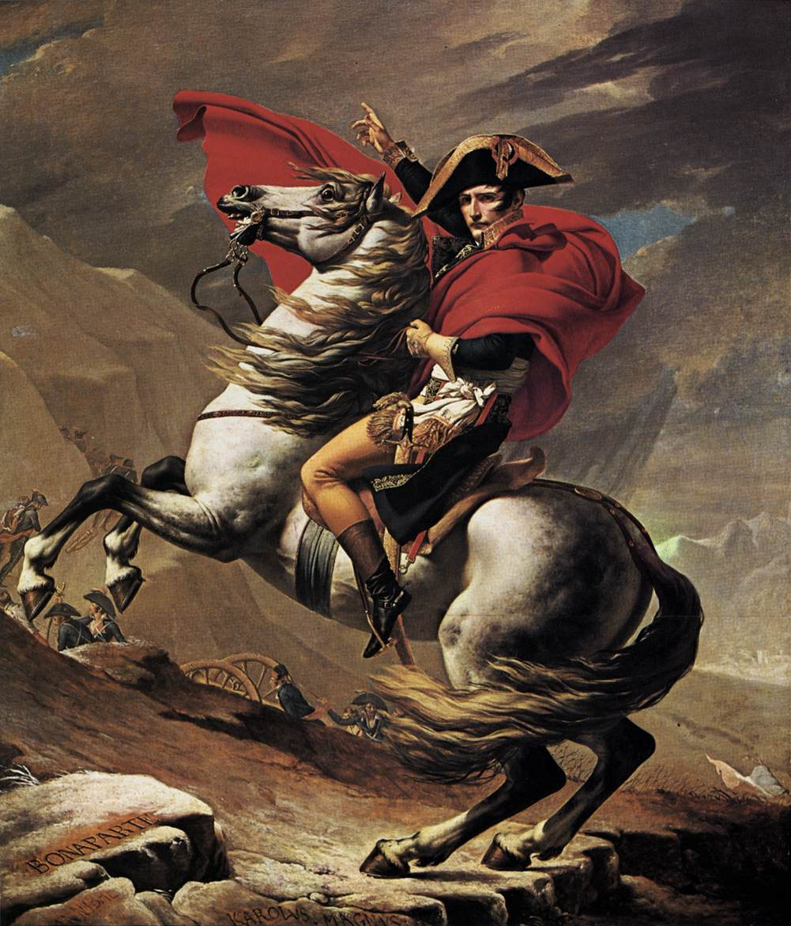
Napoleon
1800- France voted to give the 1st Counsel the majority of power
Napoleon established the Napoleonic Code
uniform system of laws.
limited the freedom of press and speech.

Slide 23
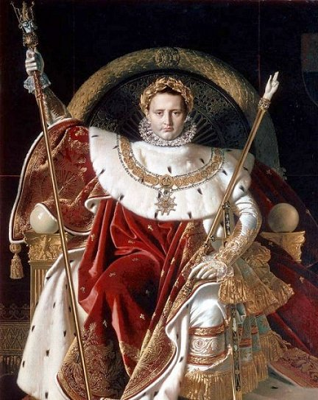
Napoleon
1804 Napoleon declared himself Emperor
Supported by the people
Wanted to expand

Slide 24
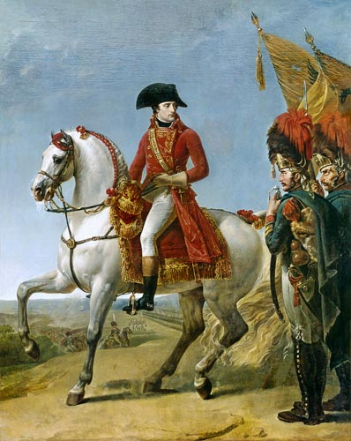
Napoleon’s Downfall
Between 1805 and 1813 Napoleon conquered much of Europe
1813 Invaded Russia
Had over 400,000 men
Russia lay over 600 miles away, with most of his men having to walk

Slide 25
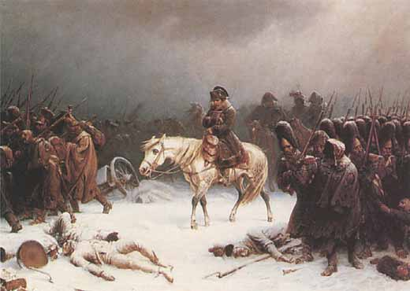
After a 3 month march, and having lost 80,000 men, Napoleon reached Moscow, only to find it abandoned and in flames
Supply lines spread thin
Winter Season
By the time Napoleon's army left Russia, it had been reduced to only 10,000 men from the original 420,000 man army.

Slide 26
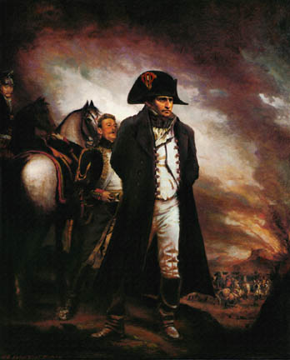
Though Napoleon was able to raise another army, he suffered his final defeat in 1815
Battle of Waterloo
Napoleon was exiled to a small island in the South Atlantic where he eventually died

Slide 27
Napoleon’s Defeat
-France’s borders were contained by stronger nations to prevent French aggression
-Many European monarchies were restored to power
- Europe gained a long lasting peace (40 years)
Result: Congress of Vienna
European powers met to set a balance of power in Europe

