Slide 1
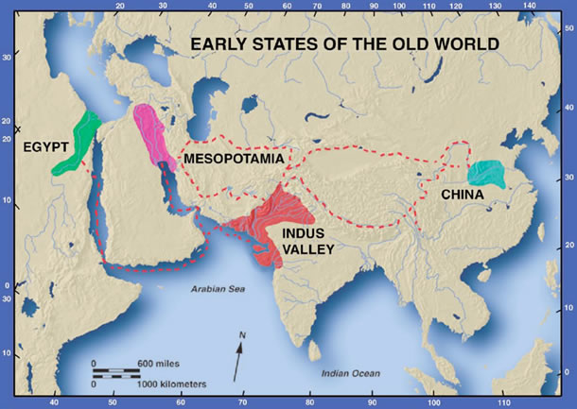
Unit 1: Ancient River Valley Civilizations

Slide 2
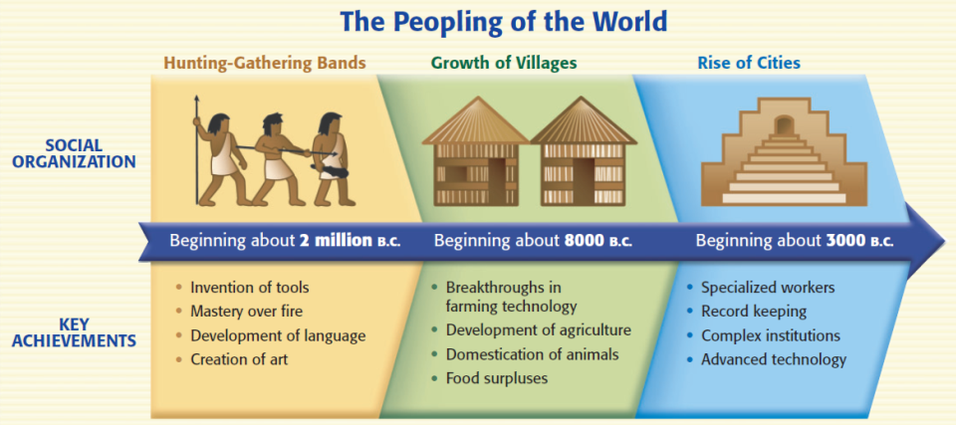
Neolithic Villages Large Scale Complex Societies

Slide 3
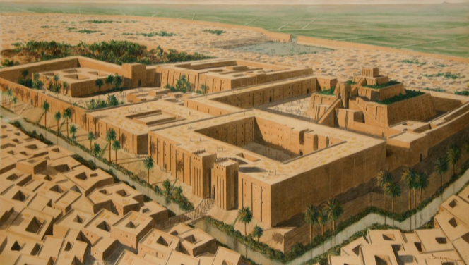
ANCIENT MESOPOTAMIA 3500-1600 B.C.
SSWH1 Analyze the origins, structures, and interactions of societies in the ancient world from 3500 BCE/BC to 500 BCE/BC.
  a. Compare and contrast Mesopotamian and Egyptian societies, include: religion, culture, economics, politics, and technology
Oldest known civilization
Mesopotamia means “land between the rivers.”
Developed in the “Fertile Crescent”
Ziggurat (right)
Hanging gardens

Slide 4
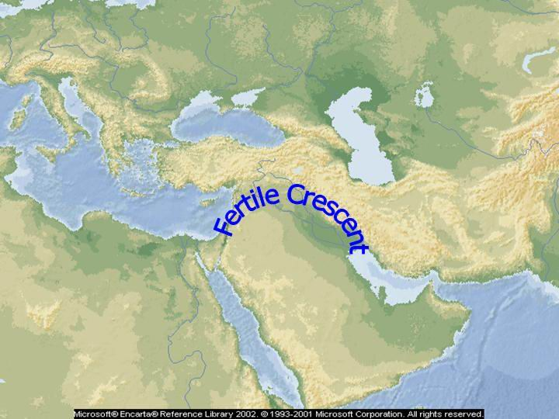
Geography
This civilization rose in the valleys between the Tigris and Euphrates rivers.
Some say this Fertile Crescent was the real Garden of Eden.
Note: It stretches from the Mediterranean Sea to the Persian Gulf, between the Tigris and Euphrates.

Slide 5
In what modern-day country was the majority of the Fertile Crescent located?

Slide 6

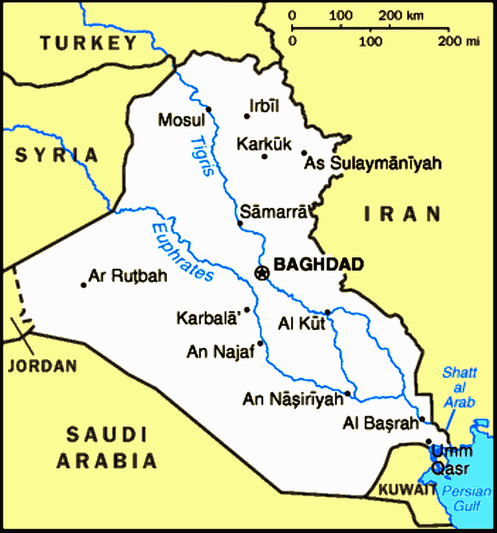

Slide 7
Farming / agriculture = increase in population
Sumer- first civilization in history
Agriculture led to population growth.
Specialization - A surplus of food allowed people to develop skills other than farming.
Growth in population led to development of social classes and government.

Slide 8
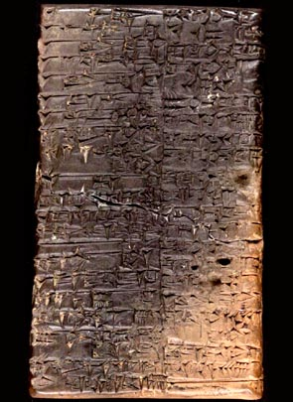
Social
& Technological
The Sumerians invented a form of writing called Cuneiform.
Mesopotamians (Sumerians, Babylonians, etc.) wrote using this “wedge-shaped” writing on clay tablets.
The first epic came from this region and was written in cuneiform: The Epic of Gilgamesh
  Oldest surviving work of literature

Slide 9
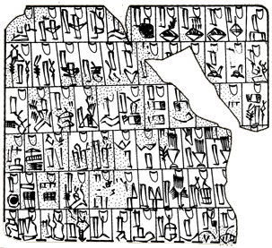
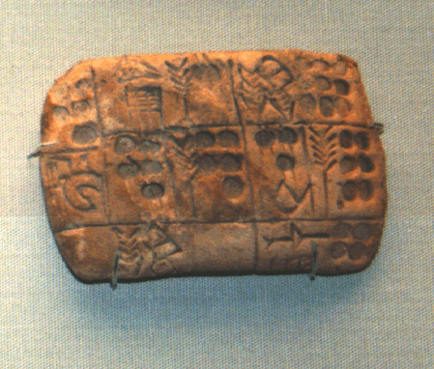
More Cuneiform Writing

Slide 10
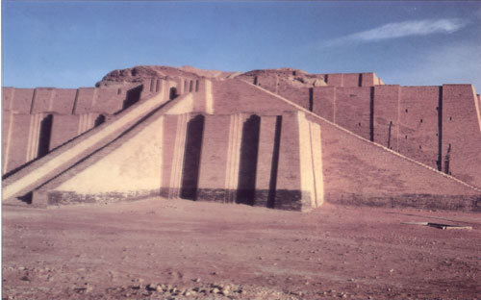
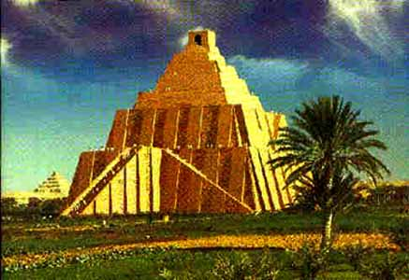
Ziggurats
To keep gods happy, Sumerians built impressive ziggurats and offered sacrifices.
Technology
  Developed arches, columns, ramps, and pyramid shapes for building as well as arithmetic and geometry.

Slide 11
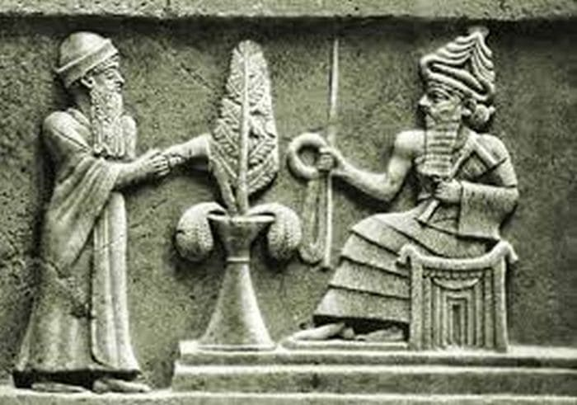
Government & Religion:
Mesopotamians were polytheistic.
  They worshipped many gods.
Temple priests controlled the earliest governments because they acted as “go betweens” with the gods.
Ziggurat = place of worship + city hall

Slide 12
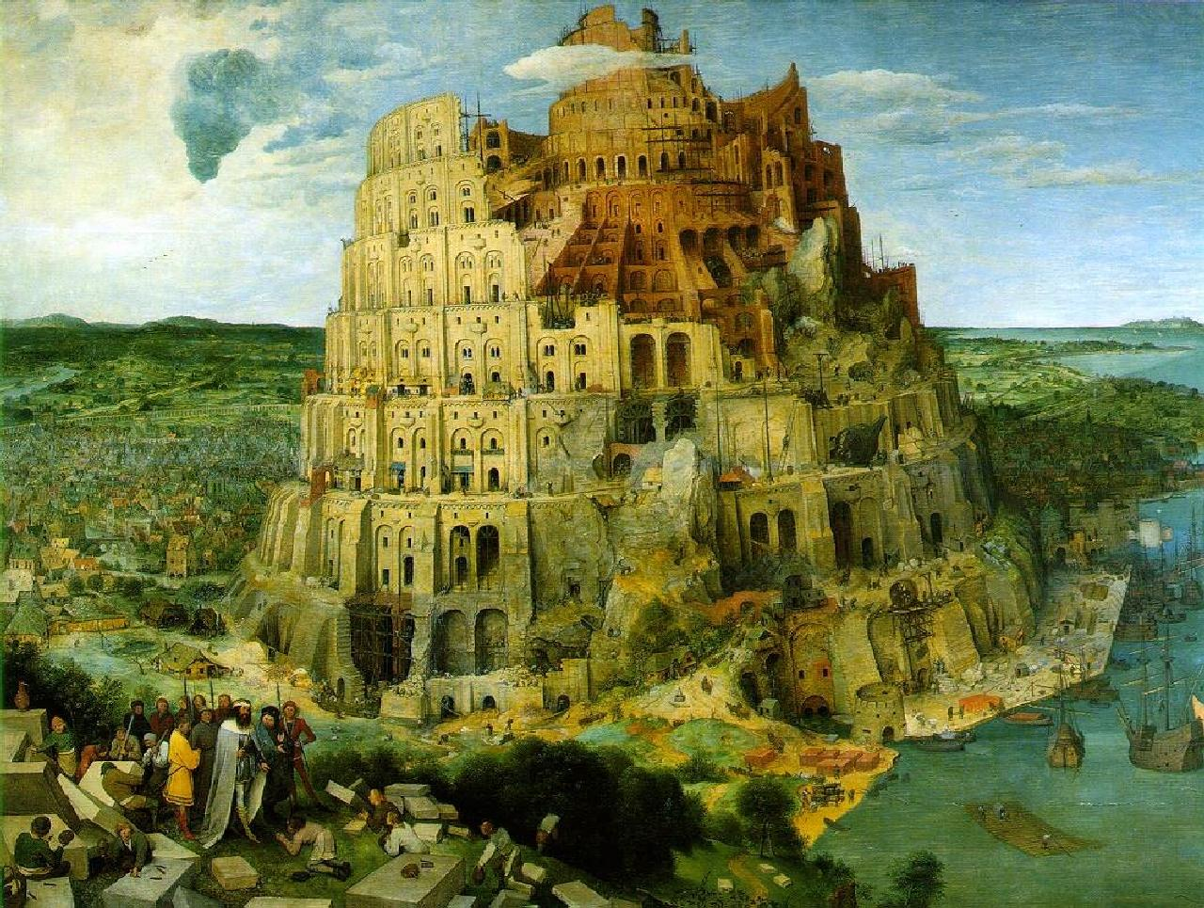
Tower of Babel

Slide 13
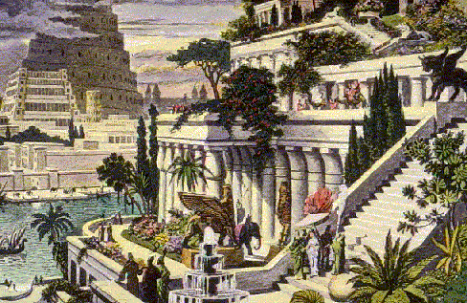
Hanging gardens of Babylon

Slide 14
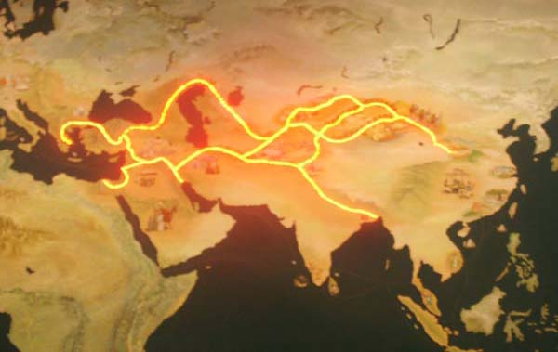
Economic: trade and farming
Sumerians (Mesopotamians) traded with the Egyptians and the Indus Valley civilizations.
In later years, these trade routes became Silk Road.

Slide 15
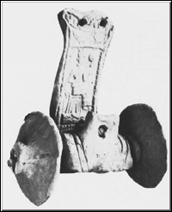
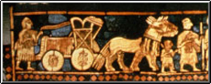
Sumerians used the wheel
The wheel was invented by 6000 BCE
It helped military, farming and trade.
At right, this is made of wood.

Slide 16
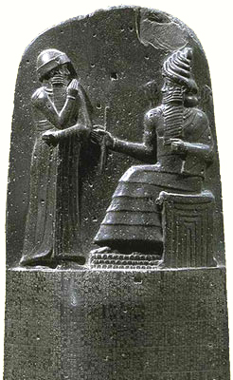
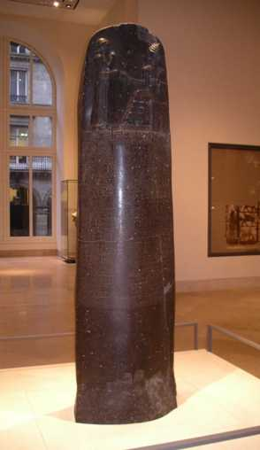
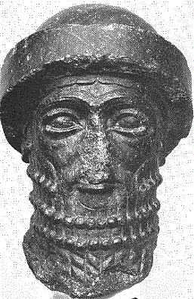
Political: Mesopotamian Law
Hammurabi's Code of Laws
  “eye for an eye" and "a tooth for a tooth”

Slide 17
Hammurabi ruled Babylon from 1792-1750BCE.
Hammurabi consolidated existing laws to create the first written law code.
Punishments were based on the crime; however, one’s social class determined the severity of the punishment. Peasants and the upper class received different punishments for similar crimes.
Mesopotamians had a patriarchal (male dominated) society.
In this particular society, men could sell wives or children to pay off debts.
Women were protected by some of Hammurabi’s laws.

Slide 18
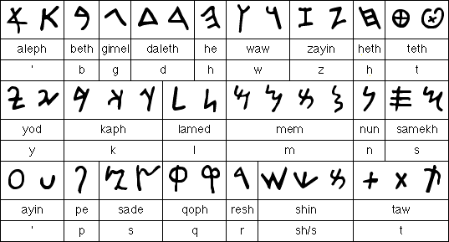
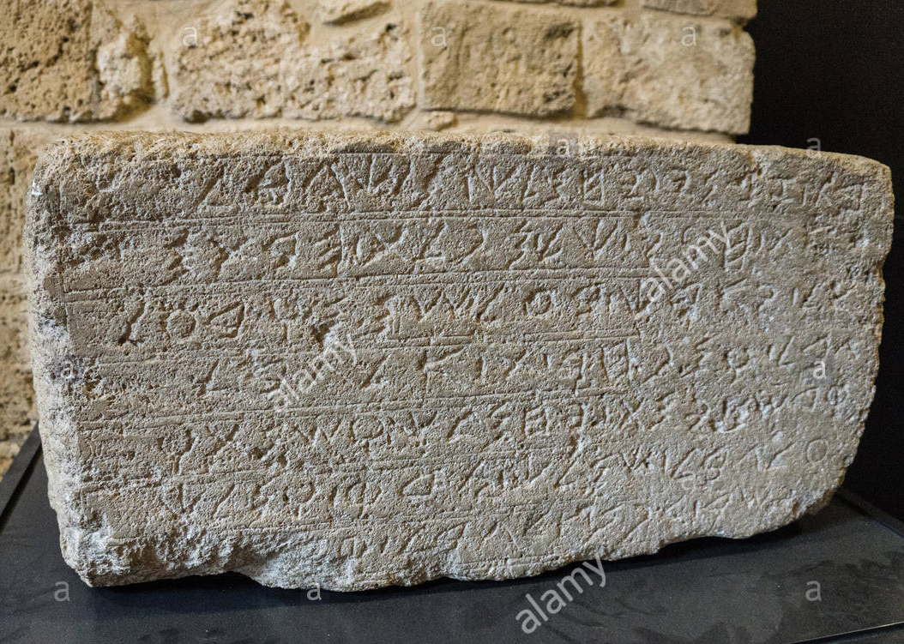
Phoenicians
Traded along the Mediterranean Sea
Created an alphabet (Greeks later based their alphabet on the Phoenician alphabet)
Advanced ship building skills
Purple dye from Murex snails

Slide 19
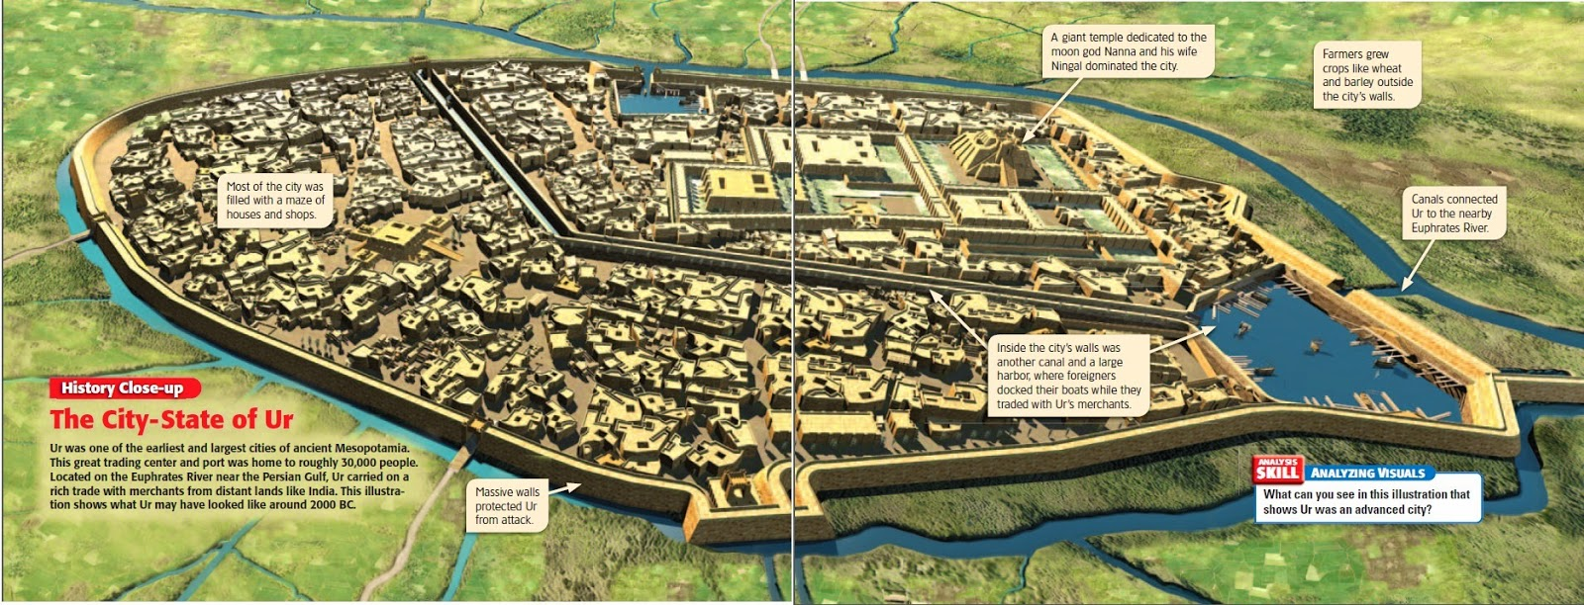
Ur, the capital city of Mesopotamia
(Abraham once lived here)
Notes:
19

Slide 20
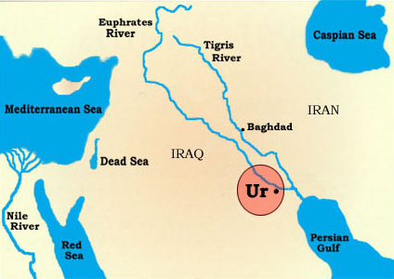

Slide 21
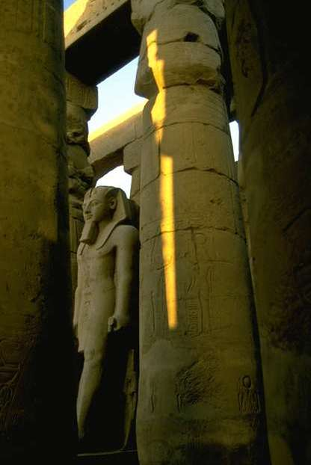
ANCIENT EGYPT
SSWH1 Analyze the origins, structures, and interactions of societies in the ancient world from 3500 BCE/BC to 500 BCE/BC.
  a. Compare and contrast Mesopotamian and Egyptian societies, include: religion, culture, economics, politics, and technology
Nile River
Mummies
Pyramids
Papyrus
Pharaohs
Rameses II
King Tutankhamen
Hieroglyphics

Slide 22
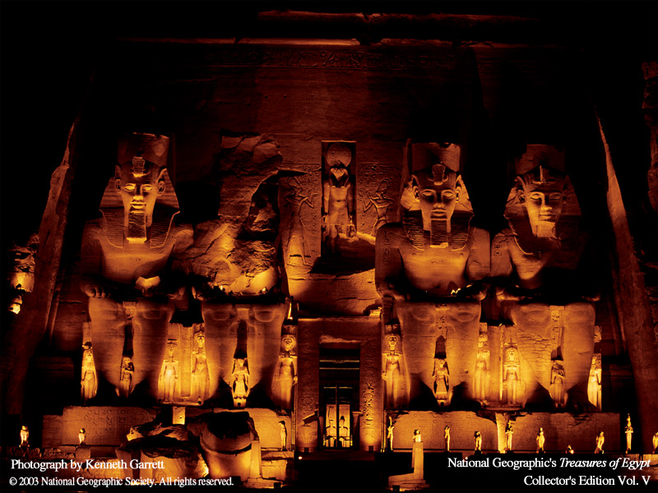
Egyptian Civilization
King Menes united Upper (southern) and Lower (northern) Egypt around 3100 BCE.
Geography: It was centered around the Nile River.

Slide 23
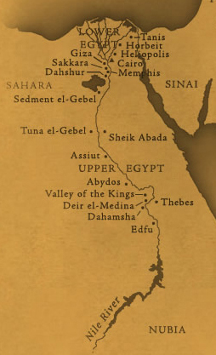
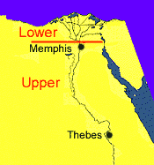
Egypt: Geography
Lower Egypt near delta
Upper Egypt middle Nile + highlands

Slide 24
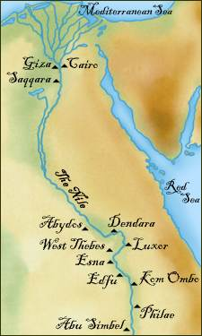
Egypt: Geography
The Nile River flows north over 4,100 miles
It is the longest river in the world
People settled on a narrow strip of land along the Nile.
The Nile flooded regularly, causing the Egyptians to view the universe as a regular and orderly place.

Slide 25
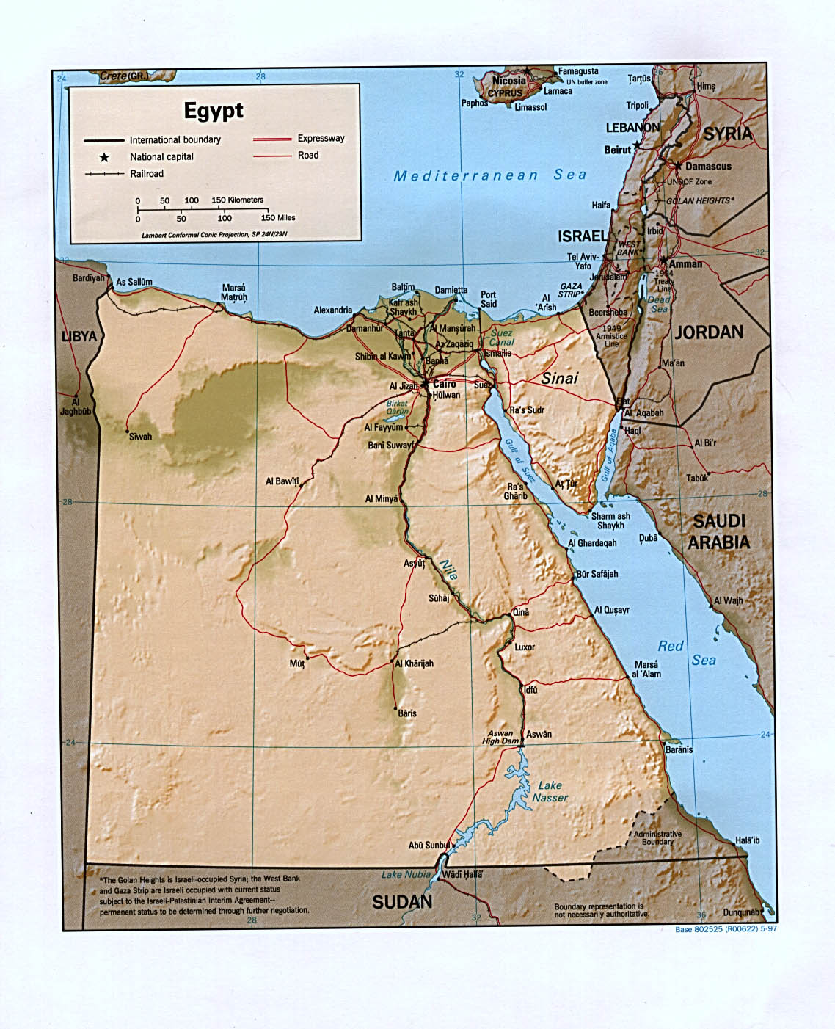
Egypt: Geography
Early history reveals that Egypt was spared the constant warfare that plagued the Fertile Crescent.
Natural boundaries protected from Egypt invaders.

Slide 26
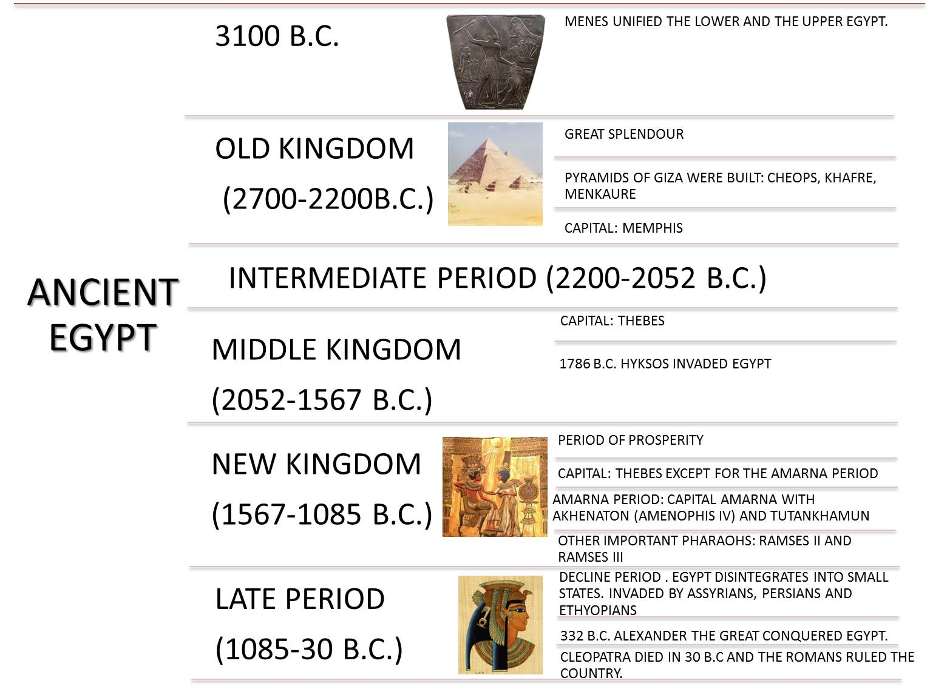
Egypt: Political
Egypt’s political organization evolved from a pattern of small states ruled by local kings to the emergence of a large, unified Egyptian state around 3100BCE.
Historians organize Egyptian history into a series of thirty dynasties falling into three longer periods: the Old, Middle, and New Kingdoms.
These three periods were divided by periods of political fragmentation and chaos.

Slide 27
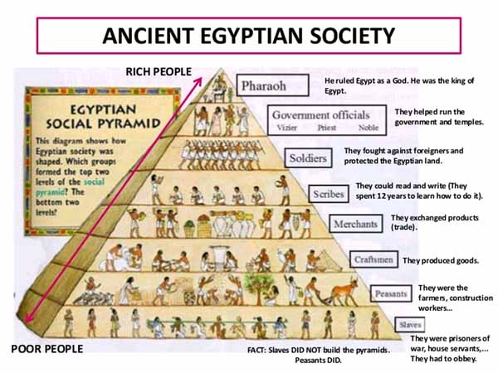

Slide 28
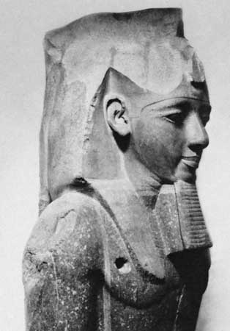
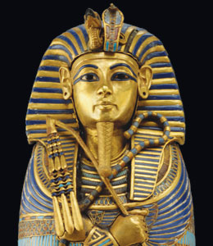
Pharaohs ruled Ancient Egypt.
They were thought of as gods.

Slide 29
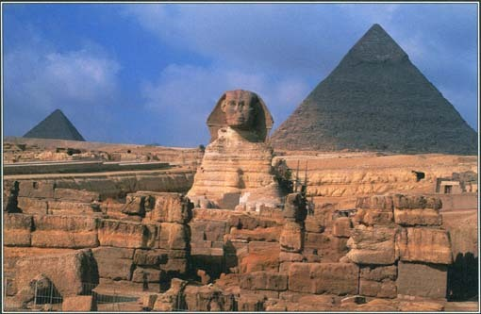
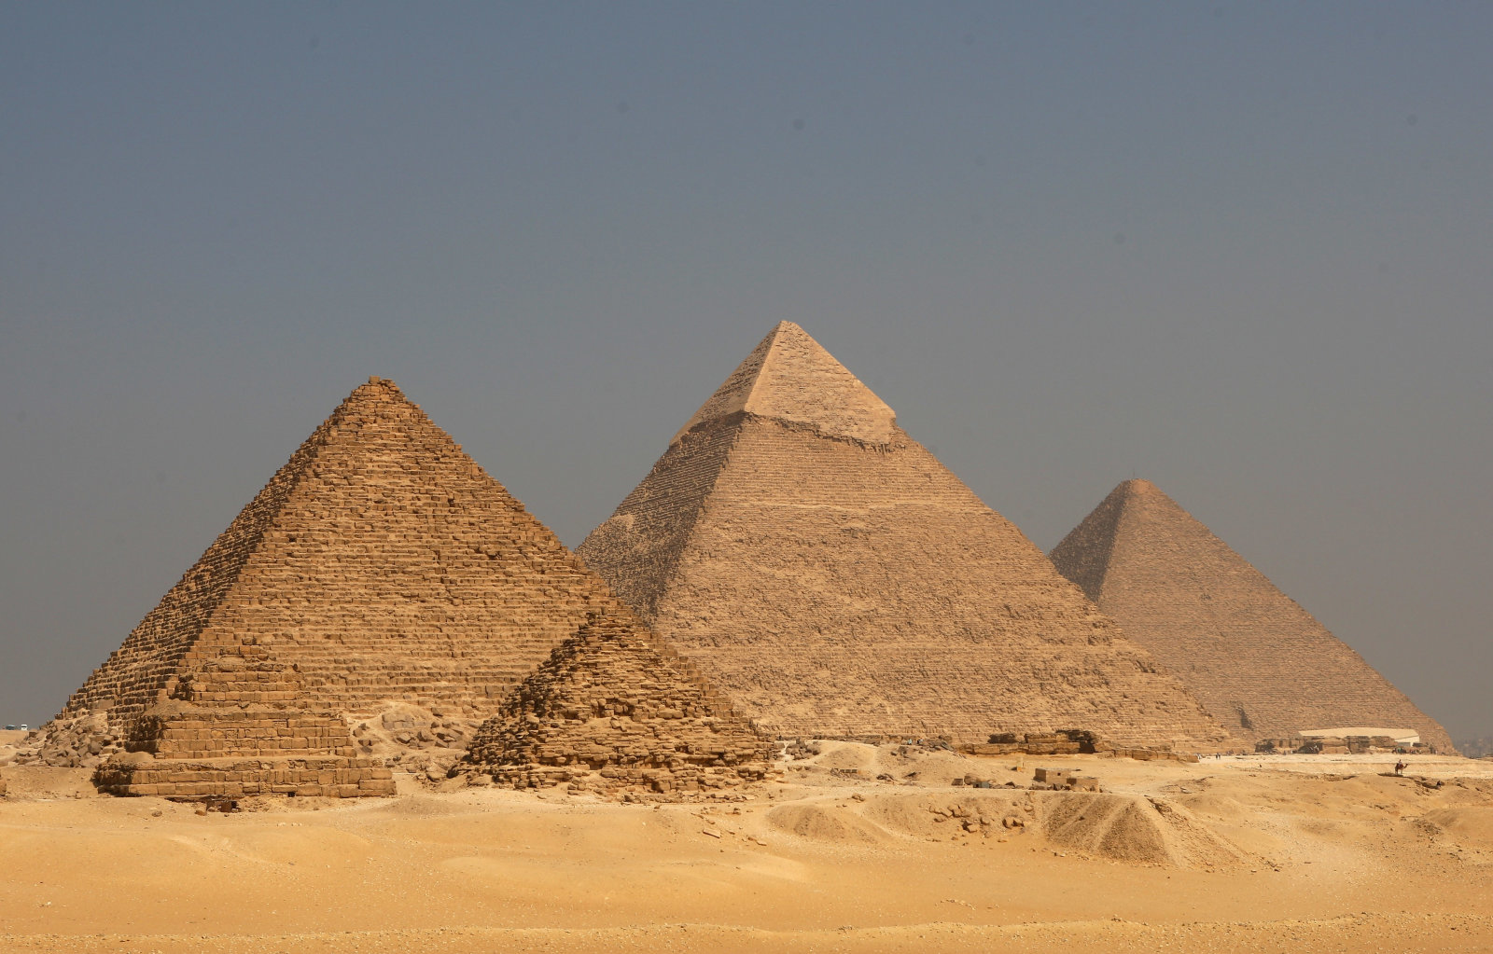
Egypt: Religion
Egyptians believed kings or pharaohs ruled even after death!!
They believed in an eternal life force called ka.
The death of a pharaoh was thought to be the beginning of his journey back to the land of the gods.
Funeral rites and proper preservation of the body were of tremendous importance.
Pyramids were built as tombs for pharaohs.

Slide 30
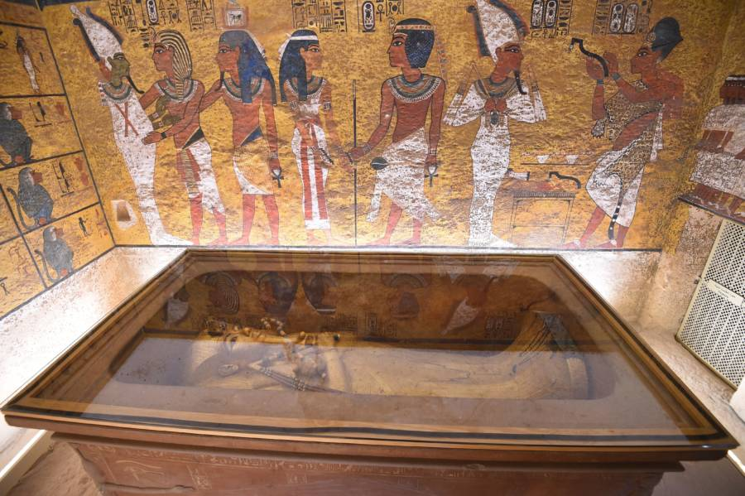
Egypt: Religion
Egyptians had a cyclical view of nature.
2 of the most important gods were Re (sun god) and Osiris (Underworld)
Egyptians constructed fabulous temples for offerings and festivals.
Egyptians generally believed in magic and in an afterlife.
Tombs (pyramids) were usually built at the edge of the desert to avoid using arable land.
Concern with an afterlife inspired mummification before burial.
The quality of each tomb reflected the social status of the deceased.
King Tut’s Tomb

Slide 31
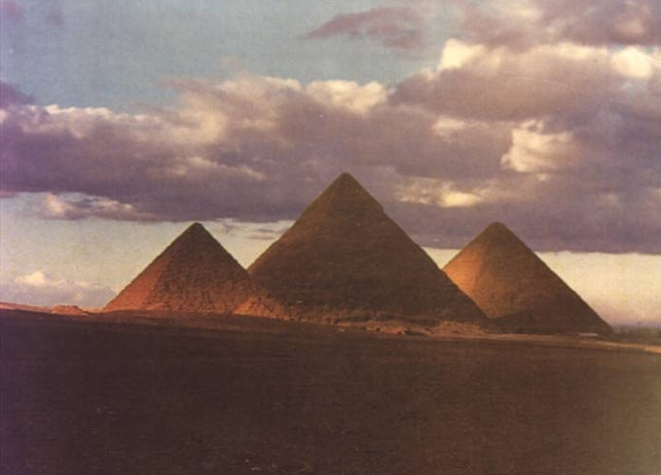
Pyramids
These are the Giza pyramids (the most famous).
These were constructed between 2550 and 2490BCE.
They were amazing engineers, considering they didn’t even have the wheel like Mesopotamians.
The main function of the pyramids were to act as tombs

Slide 32
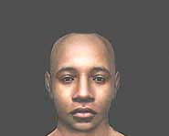
What did King Tut look like?
Using computers, this image was reconstructed using his remains.
Notes:
32

Slide 33
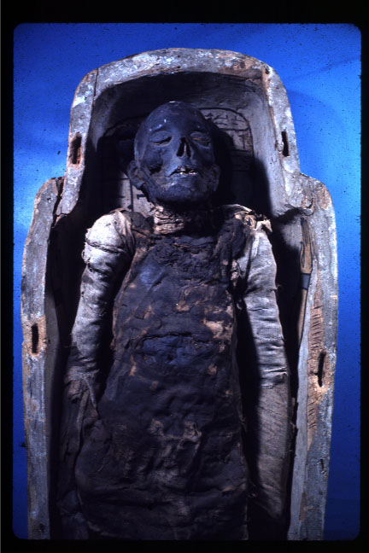
Mummies
Egyptians who could afford to do so would have themselves mummified.
They believed in a better afterlife if their body was preserved.

Slide 34
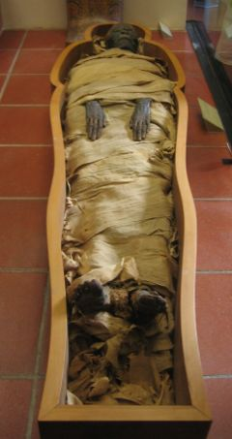
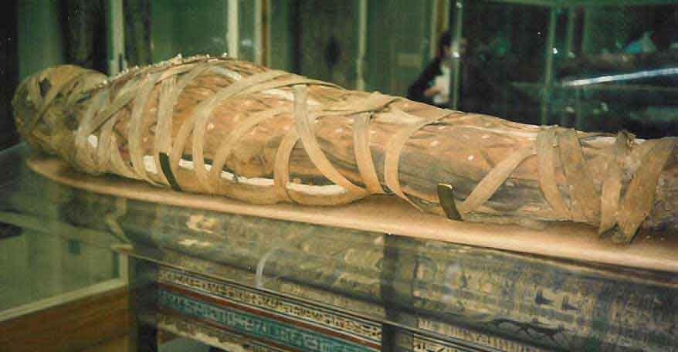
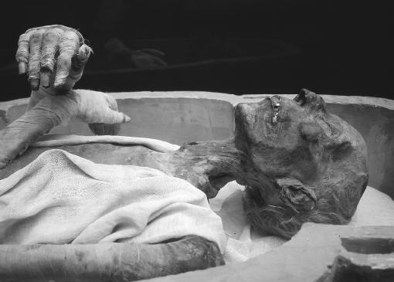
The afterlife was very important to Egyptians.
Bodies were extremely well preserved.
Embalmers were so skillful that mummies still had their hair, skin and teeth.

Slide 35
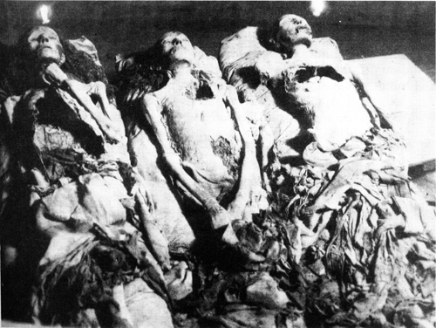
Tomb of Amenhotep II

Slide 36
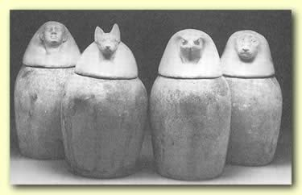
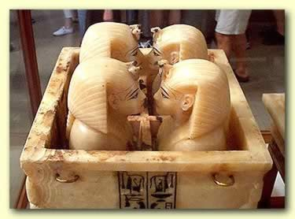
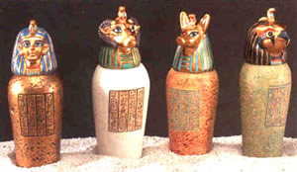
Canopic jars stored organs

Slide 37
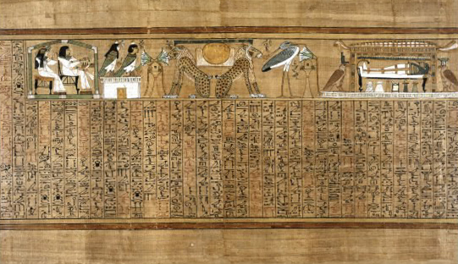
Book of the Dead
Scrolls with hymns, prayers, and magic spells to guide the dead = Book of the Dead
Tombs were filled with belongings for the afterlife

Slide 38
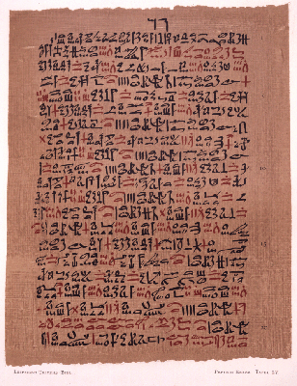
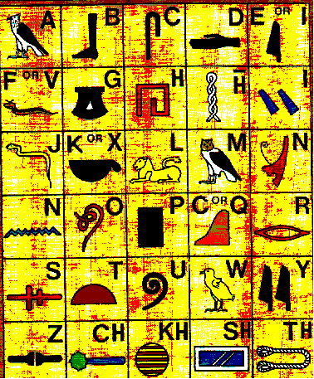
Egypt: Technology
Egyptians used a writing system called Hieroglyphics.
They wrote on papyrus which was made from reeds to form paper.

Slide 39
Monotheism
Monotheism- belief in 1 God
Torah- first 5 books of Hebrew bible (Tanakh)
Abraham- “father” of Hebrews
3 major religions trace their ancestry through Abraham and his sons, Isaac and Ishmael- Judaism, Christianity, Islam
Canaan- ancient Hebrew homeland
Covenant- promise between God and Hebrews
Moses- led Hebrews out of Egypt
Exodus- departure from Egypt
Ten Commandments- Laws given to Moses for people to follow
Israel- kingdom united under Saul, David and Solomon.
Judah- southern Hebrew kingdom
Zoroastrianism
Hebrew

Slide 40
Hebrews and Monotheism
Torah- first 5 books of Hebrew bible
Abraham- “father” of Hebrews
3 major religions trace their ancestry through Abraham and his sons, Isaac and Ishmael- Judaism, Christianity, Islam
Canaan- ancient Hebrew homeland
Monotheism- belief in 1 God
Covenant- promise between God and Hebrews
Moses- led Hebrews out of Egypt
Exodus- departure from Egypt
Ten Commandments- Laws given to Moses for people to follow
Israel- kingdom united under Saul, David and Solomon.
Judah- southern Hebrew kingdom
Zoroastrianism
Hebrew

Slide 41
Gender and Society
Paintings indicate that women were subordinate to men and engaged in domestic activities.
Egyptian women did have the right to hold, inherit, and will property and retained rights over their own dowry after divorce.
Historians believe that they had more rights than Mesopotamian women.

Slide 42

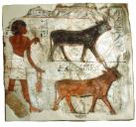



Egypt: Economy
Although Egypt looks sophisticated, the economy is a traditional economy based on farming and trade.
Egyptians traded up and down the Nile, with Mesopotamians and sometimes with Indus Valley (in Pakistan)
Notes:
42

Slide 43

Indus Valley Civilization

Slide 44


Indus Valley: Geography
Early Indian civilizations settled in an area near the Indus and Ganges Rivers

Slide 45
Indus Valley: Geography
The Indus River carries a lot of silt and floods twice a year.
Access to river water for irrigation allowed farmers in the Indus Valley and related areas to produce two crops a year, despite the region’s sparse rainfall.

Slide 46

Indus River Valley
This civilization is still mysterious.
We simply do not have all the answers..
Although a writing system existed, it has not been translated.

Slide 47


Indus River civilization
We do know the cities were sophisticated enough to have brick walls surrounding them for protection against flooding from the Indus River.

Slide 48


Two major urban civilizations were Harappa and Mohenjo-daro.
Mohenjo-Daro
Harappa

Slide 49

Indus Valley: Religion
Hinduism – oldest known religion
No one single Holy Book – many religious texts called the Vedas
Evolved from native and Aryan polytheistic beliefs
  Brahman - supreme being – creator of the universe (not worshipped directly by the masses)
  Vishnu – the sustainer – protects humanity
  Shiva – the destroyer – destroys the universe so that the cycle may begin again
Hindus believe the universe has been created and destroyed many times
Dharma: the duties of a person according to their Varna

Slide 50

Indus Valley: Religion
Your Karma in this life determines your form in the next life (higher or lower Varna)
Reincarnation – cycle of life and rebirth (Samsara)
Goal: to escape this cycle and be reunited with Brahman
Effects of Hinduism on Society
~ reinforced social hierarchy (Caste System)
~ promoted high ethical standards
~ respect for all living things
~ promotes a vegetarian diet and honors the sacred cow
~ bathe in the river Ganges

Slide 51


Indus Valley: Religion
Buddhism
Came from the enlightened ideas of Siddhartha Gautama (Founder).
Preached basic principles of the Four Noble Truths
-Life is full of suffering
-Suffering is caused by wants
-To end suffering, stop wanting things
-To stop wanting things, follow the eightfold path (enlightenment)

Slide 52

Indus Valley: Architecture
These cities of the Indus Valley civilization are characterized by a high degree of standardization in city planning, architecture, and even by the size of the bricks.
Two possibilities – could have had an authoritarian central government or may have had extensive trade within the region.

Slide 53

Indus Valley: Economy
Just like the other river valley civilizations, the Indus river valley people were mostly farmers.
Traditional economy (Agriculture)
Extensive Trade
They traded with areas in China, Afghanistan, Iran, and with Sumerians (Mesopotamians).

Slide 54
Indus Valley: Technology
Had better access to metal than did the Egyptians and Mesopotamians.
Used metal to create everyday items and luxury items.
Had extensive irrigation systems, the potter’s wheel, kiln-baked bricks, sophisticated bronze metallurgy, and a system of writing.

Slide 55

The cities of Harappa and Mohenjo-daro had well planned streets, plumbing, public works, brick walls, and sewage systems.

Slide 56
Indus Valley: Fall
Believed to be abandoned by 1900 BCE
Natural disasters and ecological changes such as the drying up of the Ghaggar -Hakra River, salinization, and erosion probably led to a decline in agricultural production and the collapse of the Indus Valley civilizations.
Indo-European Aryans, migrated into the region in about 1500 BCE. This group eventually established the Magadha Kingdom which controlled a portion

Slide 57

Later, the Aryans settled the region through multiple invasions.

Slide 58
Mauryan Empire: Rise
Chandragupta Maurya- Founding Emperor (c. 322 BCE)
  northeastern and northwestern India were joined; strict policies held the empire together
Ruled by hereditary monarchs
Had a powerful standing army that included elephant, chariot, and cavalry divisions.
Agriculture – primary economic activity
Had an extensive network of roads
Maritime trade with Southeast Asia and the Middle East

Slide 59

Mauryan Empire
Ashoka (269 BCE)
  brought empire to its greatest height
  felt a great sorrow and guilt after a battle, then decided to accept the teachings of Buddha
  Promoted Buddhism as state religion and erected pillars that promoted the teachings of the Buddha.
  practiced religious toleration,
Kingdom fell in 184 BCE to due invasions.
Stupa. Great Stupa (3rd century BC), Sanchi, India. Ashoka ordered the construction of 84,000 stupas to house the Buddhas relics.

Slide 60

Gupta Empire
Chandragupta
  after 500 years of turmoil, united empire (320 CE)
  Modeled his rule after the Mauryan Empire
Samudragupta (c. 335 CE – c. 375 CE)
  Golden Age: kept conquering others; strict class system; practiced Hindu; developed numbers/ decimals
Chandragupta II (375 CE – 415 CE)
  defeated the Sakas in the west and added their coastal territory; strengthened empire by peaceful means
Coin of Samudragupta, with Garuda pillar. British Museum.

Slide 61




What are artifacts?
an object made by a human being, typically an item of cultural or historical interest.

Slide 62



Knowledge of this civilization is gained from archaeological excavations.

Slide 63

ANCIENT CHINA
Dynasties
Great Wall
Confucianism
Daoism
Legalism
Mandate of Heaven
Silk

Slide 64

Ancient china: Geography
As in Egypt, Mesopotamia, and along the Indus River, Chinese civilization began within a major river valley.
  Huang He and Yangtze Rivers
  Modern China itself is a huge geographical expanse.
The eastern zone can be divided into 2 parts:
Northern | Southern
Yellow River Valley Dry, cold climate Loess soil Suitable for growing millet | Yangzi Valley Plentiful rainfall, relatively warm Rainy, suitable for cultivating rice

Slide 65

Ancient China: Geography
Ancient China was formed around the Yellow River (Huang He).
Yellow symbolized “centrality”, as in China is the center of the world. The color was caused by the loess in the water.
Because of flooding, the Yellow River (Huang He) is also known as “China’s Sorrow”.

Slide 66

Ancient China: Political
The first known dynasty of China was the Shang dynasty.
This dynasty united the people living around the Huang He and Yangtze river valleys.

Slide 67



Ancient China: Political
Shang Period (1750-1045BCE) – 1st Dynasty
  Before the Shang, Neolithic communities had domesticated pigs, chickens, and millet.
The Shang developed the Chinese writing system.
  Therefore Chinese history begins with the Shang.
This writing has been found on oracle bones dating back to the Shang.
Believed their supreme god, Di, could only be reached through the ruler’s ancestors. This provided rationale for authoritarian rule.
The Shang elite was a warrior aristocracy. They enjoyed hunting and warfare.
Bronze metallurgy began around 2000BCE.
  Used bronze weapons and rode on horse-drawn chariots.

Slide 68

Notes:
68

Slide 69

Ancient China: Political
The Zhou Dynasty – 2nd Dynasty (c. 1027 to 221 BCE)
  The Zhou territory was a dependent state of the Shang.
  The Zhou overthrew the Shang around 1045 BCE and adopted many elements of Shang culture.
Zhou rulers claimed the divine right to rule
  the Mandate of Heaven.
King Wu created a land distribution system like feudalism.
Capital city was built in a grid pattern and aligned with the north polar star. This design followed their ancient belief in feng shui to maintain harmony.
.

Slide 70

Ancient China: Political
Technology (Zhou Dynasty) Innovations:
  built roads and canals
  coined money / helped trade
  furnaces produced cast iron
  advancements in agriculture
  Learned to fight on horseback and replaced bronze with iron and steel.
Development of the concept of private property, including privately owned land.
Women were subordinate to men in this patriarchal society.
  Their subordinate position was justified by the concepts of yin and yang.
Copper Coins used during the Zhou Dynasty

Slide 71

Ancient China: Political
By 480 BCE, Zhou lost control and China was thrust into the Warring States Period

Slide 72

Ancient China: Political
Qin Dynasty (c. 221-226 BCE)
  Established by Shi Huangdi
Legalism
  Humans were innately self-serving and destructive
  Societal order to be maintained with strict laws and harsh punishments
He attacked invaders, crushed political opposition, and seized the land of nobles.
He murdered hundreds of Confucian scholars and ordered their books to be burned.
He established an autocracy (government with unlimited power).

Slide 73

Ancient China: Political
Qin Dynasty
  Credited for unifying China politically, economically, and culturally.
Centralization included:
  Building of a highway network of more than 4,000 miles.
  Same writing
  Law
  Currency
  Weights and measures (even down to the length of cart axles).

Slide 74


Ancient China: Technology
The Great Wall of China
  Shi Huangdi added on to smaller walls built by the Zhou
  He extended the wall nearly the length of the Qin empire’s border.
Peasants did not get paid for their work. They were threatened with death.
Many died from crushing labor or harsh winters.
.

Slide 75

The Great Wall of China was built to keep out the Mongols.
Notes:
75

Slide 76

Ancient China: Political
Fall of the Qin Dynasty
  forced labor and excessive taxation quickly led to rebellion
  Shi Huangdi died in 210 BCE,
  3 years later, Chinee peasants rebelled against Shi Huangdi’s son.
The Han Dynasty followed the Qin Dynasty
  Would eventually become the longest lasting Dynasty in Chinese History
  Emperor Liu Bang
    Blended legalism with Confucianism for lasting prosperity
    Civil service examinations

Slide 77

Ancient China: Economy
Han Dynasty
  thriving economy extensive internal and international trade
  export of silk.
  advancements in farm technology like the horse collar and better irrigation.
Silk was exotic and expensive, so it was good for trading with the rest of the world.
Silk also makes “paper”
Notes:
77

Slide 78

Silk worm
Notes:
78

Slide 79


Ancient China: Religion
Confucianism
  Founded by Confucius
  China’s most influential scholar.
Born in 551 BCE, he lived during a time when the Zhou dynasty was in decline.
His childhood was a time of crisis and violence in China.
He had a deep desire to restore the moral order of earlier times.
He thought people should abide by a code of proper conduct within their relationships.

Slide 80

Ancient China: Religion
Filial Piety
  children should practice respect for elders
Believed in bettering oneself through education
Set the foundation for bureaucracy and civil service
Ideas have spread to many other parts of the world
Established the idea of the Mandate of Heaven: God gives strength to overtake weak rulers

Slide 81

The Five Relationships
Ancient China: Religion
Ruler to subject
Parent to child
Husband to wife
Elder to younger sibling
Friend to friend

Slide 82
Confucianism vs. Daoism
Confucianism assumes human nature is essentially good.
Has a hierarchical view of the universe, society, and family.
Concerned with establishing the moral foundations of government.
Daoism assumes that there are not absolute moral standards, and that people should take the world as they find it.
Developed into a system of popular beliefs and magic.

Slide 83


