Slide 1
Ancient Greece
Fill in the Blank

Slide 2
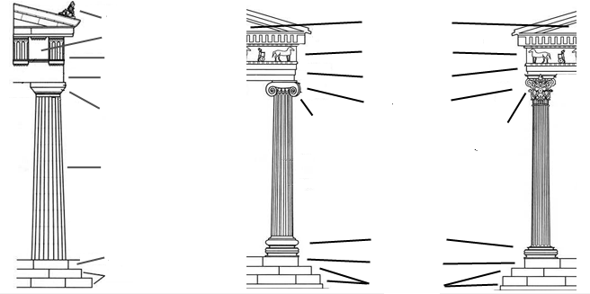
Fill in the Blanks - Types of Columns
label
label
label
label
label
label
label
label
label
label

Slide 3
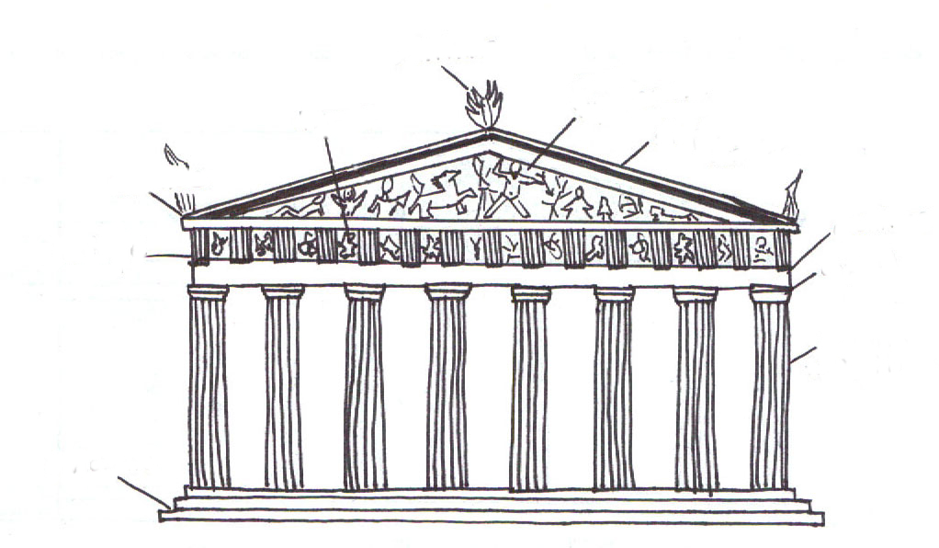
Fill in the Blanks - The Parthenon
label
label
label
label
label
label
label
label
label

